Slide 1



Digital Signals
Supervised Learning - ML - DL
Prepared By :
1
Manar El Fakih Romdhane

Slide 2
Plan
Problem & Data Overview
Preprocessing
Modeling
Results
Deployment
2

Slide 3

Problem Definition
Mental health disorders often remain undetected because people tend to express emotional distress online before seeking professional help. Social media and online forums contain valuable early warning signals, but identifying them manually is difficult due to the large volume of data.
===> AI & NLP offer an opportunity for automated, scalable risk awareness
3

Slide 4

Dataset Description
Dataset | Source | Samples | Original Labels
df1 | twitter | 7,517 | Anxiety/Normal/Depression/Suicidal…
df2 | Kaggle | 1,487 | suicide / non-suicide
df3 | Kaggle | 2,218 | 0 / 1 (binary)
df4 | GitHub | 700 | Anxiety/BPD/depression…
df5 | Mendeley | 911 | Unlabelled
11,917
52.9%
30.1%
17.0%
Total clean samples
High Risk
Low Risk
Moderate Risk
4
Target Variable: risk_level ∈ { low_risk, moderate_risk, high_risk }

Slide 5
Data Preprocessing
01
Text Normalization
02
Noise Removal
Lowercase · remove whitespace · standardize encoding
Strip URLs · @mentions · HTML tags · punctuation · numbers
03
Tokenization & Lemmatization
04
Quality Filtering
WordNetLemmatizer → base forms | Custom stopword list
Drop texts < 3 tokens · remove duplicates & nulls
05
Label Harmonization
06
Semi-Supervised Labelling
Map 5 schemas → low/moderate/high_risk
Pseudo-label df5 & df2 non-suicide via LR baseline (conf ≥ 0.80)
Train / Test Split Strategy:
ML Models: Train 80% · Val · Test 20%
BiLSTM: Train 70% · Val 15% · Test 15%
5

Slide 6
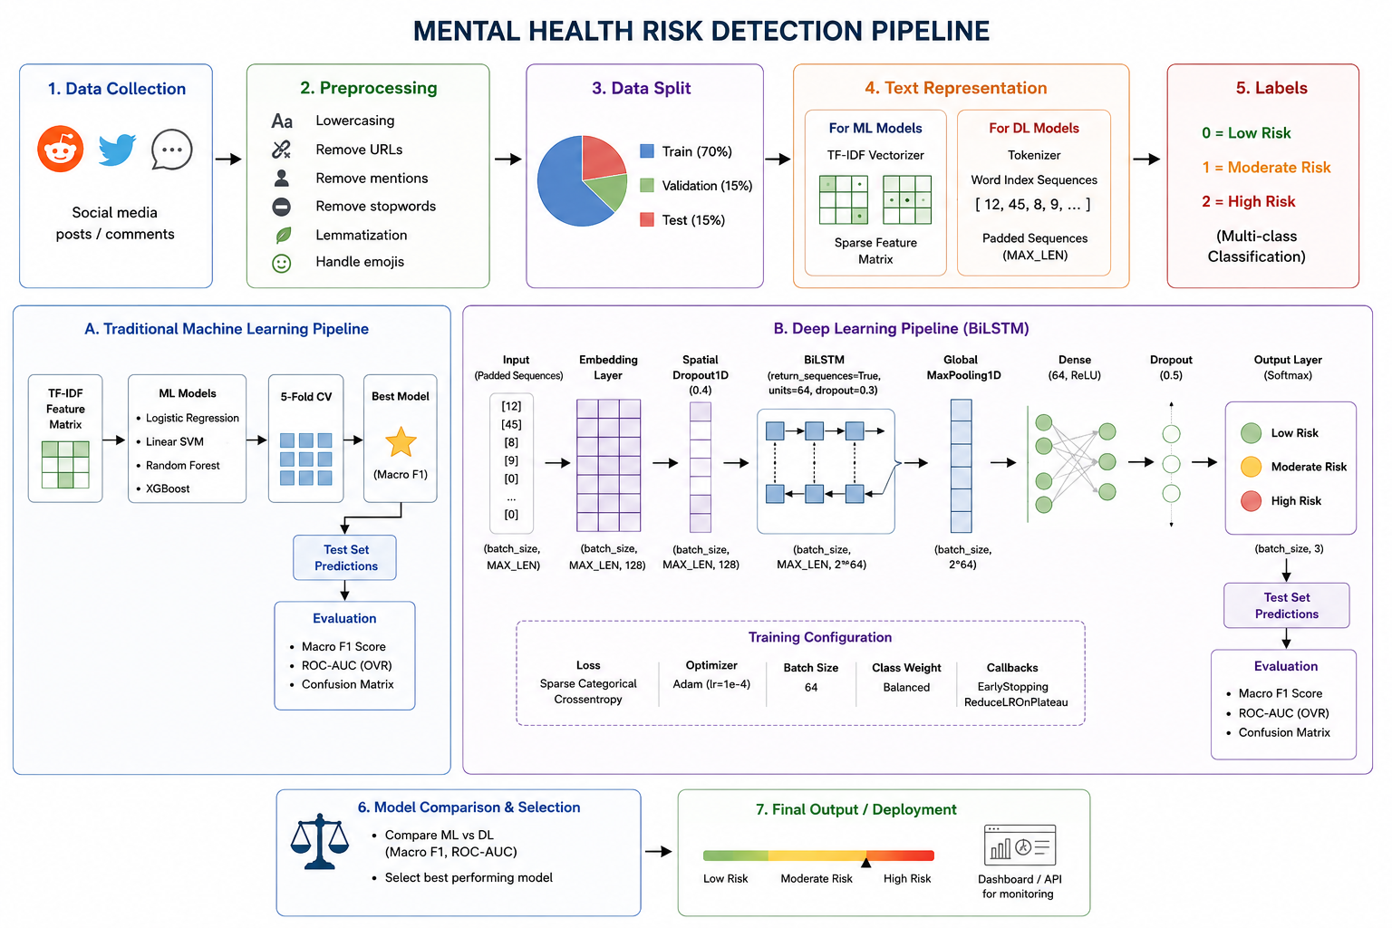
6

Slide 7
Implementation & Model Development
ML Pipeline
BiLSTM Configuration Progression
Raw Text
Baseline
lr=1e-3, LSTM=64, return_seq=False
Reference
↓
TF-IDF Vectorizer
FT-1 ★
lr=1e-4, LSTM=32, dropout↑
Best DL
↓
Classifier (LR / SVM / RF)
FT-2
return_seq=True + GlobalMaxPool
Improved
↓
Risk Class + Confidence
Hyperparameter Tuning LR (best config)
Implementation Environment
max_features
15,000
IDE
VS Code
ngram_range
(1, 2) — bigrams
ML
scikit-learn
C (regularisation)
10.0
DL
TensorFlow 2.12 / Keras
CV F1 (train)
0.8229
NLP
NLTK 3.8
Test F1
0.8343
App
Flask
Test ROC-AUC
0.9557
Explain
SHAP-inspired coefficient attribution
7

Slide 8
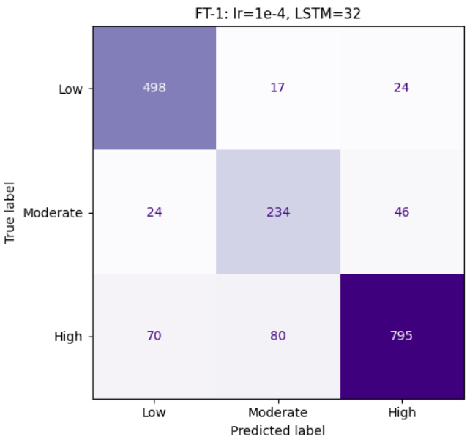
Results
Model | Macro F1 | ROC-AUC | High Recall | Critical Errors ↓
Logistic Regression ★ (best F1+AUC) | 0.8343 | 0.9557 | 0.87 | 73
Linear SVM | 0.8294 | 0.9478 | 0.89 | 79
Random Forest | 0.7641 | 0.9374 | 0.90 | 108
BiLSTM (Baseline) | 0.8269 | 0.9542 | 0.82 | 68
BiLSTM FT-1 ★ (best safety) | 0.8368 | 0.9472 | 0.85 | 41
BiLSTM FT-2 | 0.7916 | 0.9305 | 0.78 | 41
8

Slide 9

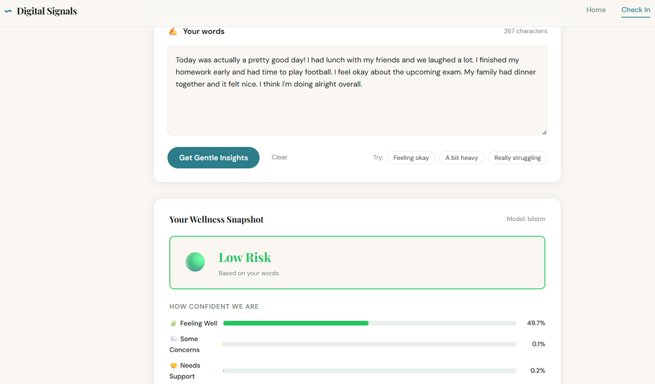
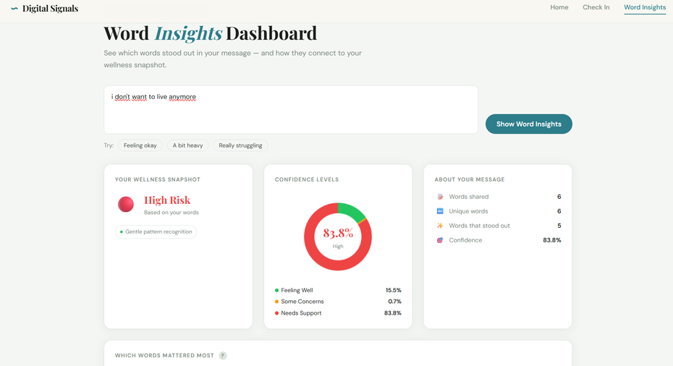
Deployment
9

Slide 10

10

